Slide 1
QA – Automation Tester Certification
Test Automation Engineer – Preparation Course – Session 02

Slide 2
QA – Automation Tester Certification
Content
01. UI Web based application Automation
Selenium Webdriver, BDD Gherkin Language, Specflow, Page Object Model
02. Backend API Rest Automation
GET / POST / PUT / DELETE requests
Postman, ResponsibilityChain pattern
03. UI Android application Automation
Appium, Locators in Android
04. Continuous Integration over Azure Environment
Vstest Executor
Pipelines
Reporting
Selenium Grid

Slide 3

01. UI Web based application Automation
Selenium: How to Start a New Project
API Rest
Requests & Format

Slide 4
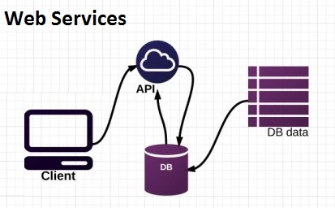
02. API Rest
2.1 API Rest
A RESTful API is an application program interface (API) that uses HTTP requests to GET, PUT, POST and DELETE data.

Slide 5
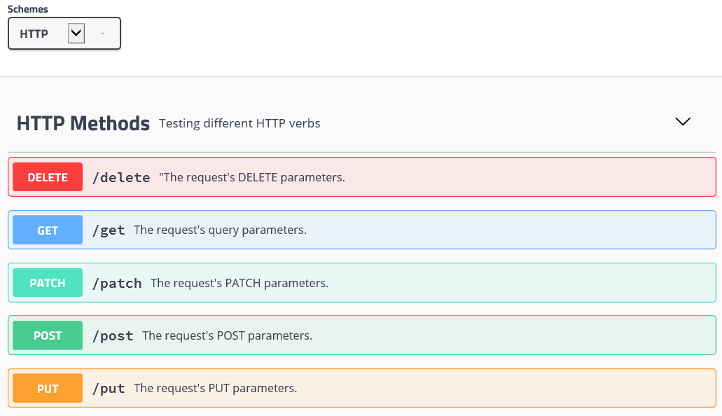
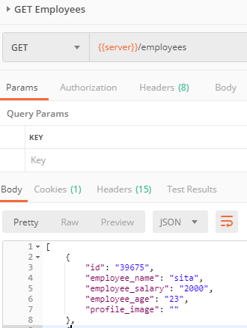
02. API Rest
2.2 API Rest: Requests

Slide 6
01. UI Web based application Automation
Selenium: How to Start a New Project
PRACTICE
POSTMAN

Slide 7
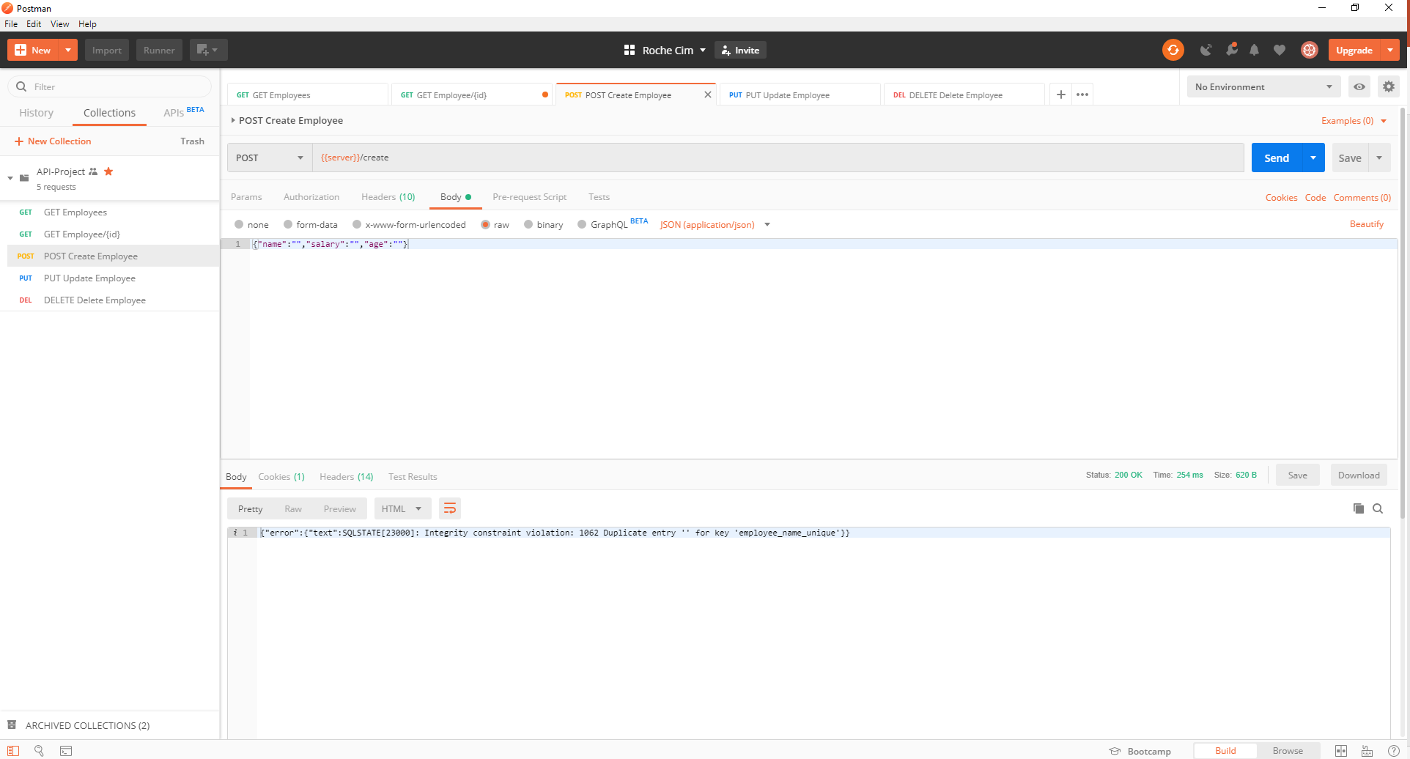
02. API Rest
2.3 Practice: Postman
API: http://dummy.restapiexample.com/
/employees
/employee/{id}
/create
/update/{id}
/delete/{id}

Slide 8
01. UI Web based application Automation
Selenium: How to Start a New Project
PRACTICE
RestSharp

Slide 9
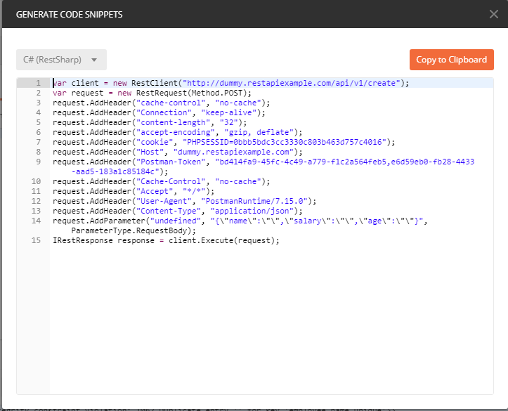
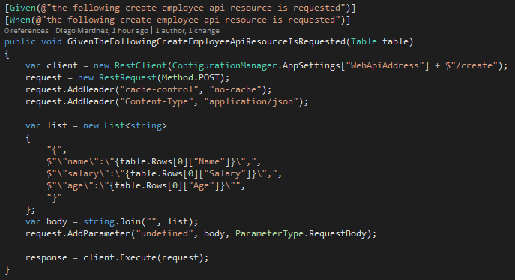
02. API Rest
2.4 RestSharp

Slide 10
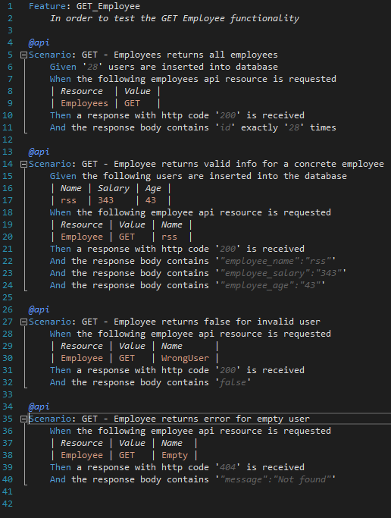
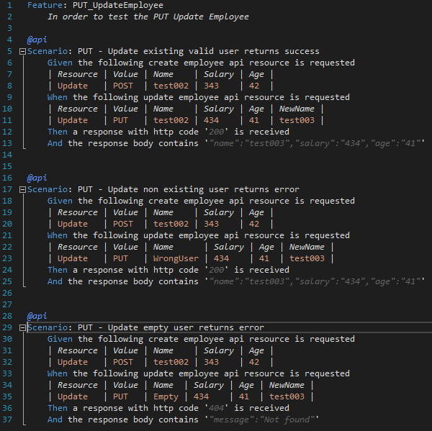
02. API Rest
2.5 Page Object Model

Slide 11

Diego Martínez Gilabert
diegomartinezgilabert@erni-espana.es

